Slide 1

HEART DISEASE PREDICTION SYSTEM

Slide 2
INTRODUCTION
The Heart Disease Prediction System is a machine learning project developed using Python Django. It employs a Gradient Boosting Classifier algorithm to predict heart disease. The system consists of three main modules: user, admin, and doctor. Users can sign up, log in, make predictions, view prediction history, and access recommended doctors based on their area. Admins can manage users, view prediction results, and access other administrative functionalities. Doctors can log in, view patient histories from the same city, and manage their profiles. The system utilizes a dataset with various parameters to accurately predict the presence of heart disease.

Slide 3
OBJECTIVE
The objectives of the Heart Disease Prediction System using Gradient boosting classifier project are:
To develop a machine learning model that can accurately predict the presence of heart disease in patients based on their medical parameters.
To create a user-friendly web application that allows users to input their medical parameters and receive a heart disease prediction in real-time.
To provide users with access to recommended doctors based on their area of residence.
To provide doctors with access to patient information in their area to generate leads.
To provide administrators with access to key metrics related to user and prediction counts, as well as user and doctor registration information.
To ensure data privacy and security by implementing appropriate security measures for user data.

Slide 4
GOAL
The goal of the Heart Disease Prediction System using Gradient boosting classifier is to provide an accurate prediction of the likelihood of a patient having heart disease based on their medical history and certain parameters such as age, sex, blood pressure, cholesterol level, and other relevant factors. This system aims to help doctors in making a timely and accurate diagnosis of heart disease, leading to early treatment and better patient outcomes. Additionally, the system aims to provide a user-friendly interface for patients to assess their risk of heart disease and access information about recommended doctors in their area.

Slide 5
NEED OF THE SYSTEM
The need for the Heart Disease Prediction System using Gradient boosting classifier arises from the increasing prevalence of heart diseases and the need for accurate and timely diagnosis to improve patient outcomes. Early detection and prediction of heart disease can help healthcare providers develop effective treatment plans and prevent adverse events. This system can aid in reducing the mortality and morbidity rate associated with heart diseases by providing an accurate prediction of the likelihood of heart disease, which can help doctors make better-informed decisions about the patient's care. Additionally, the system can enable patients to take preventive measures and adopt lifestyle changes to reduce their risk of developing heart disease.

Slide 6
PROPOSED SYSTEM
The Heart Disease Prediction System is a web application developed using Python Django and a SQLite database. It predicts the likelihood of heart disease based on various parameters. The system has user, admin, and doctor modules, allowing users to make predictions, view history, and find recommended doctors. Admins can manage users and view system metrics, while doctors can access patient histories. The system aims to provide an intuitive interface for predicting heart disease and assisting in early prevention and treatment.

Slide 7
PREDICATABLE ATTRIBUTE
Diagnosis value 0:<50% diameter narrowing(no heart disease)
Value 1:>50% diameter narrowing(has heart disease)
Input Attributes :
Sex
Chest Pain Type
Fasting Blood Sugar
Restecg
Exang
Slope

Slide 8
PREDICTABLE ATTRIBUTE (Continue)
Input Attributes :
CA – number of major vessels colored by floursopy
Thal
Trest Blood Pressure
Serum Cholesterol
Thalach – maximum heart rate achieved
Oldpeak
Age in Year

Slide 9
PREDICTION OF HEART RISK
Now to predict the risk of heart disease, user can enter the values of various parameters on the basis of which his risk factor will be calculated.
After entering all the values, click on Predict button.
The page will be reloaded and the result will be shown according to ML.
If result is 1, user has risk of heart disease. If result is 0, user does not have a risk of heart disease.
The user can also view his profile and previous predicted results by clicking on Profile tab.

Slide 10
USER MODULES
Signup: Allows new users to create an account by providing necessary details such as name, email, password, etc.
Login: Allows registered users to log in to their account by providing their email and password.
Prediction: Enables users to predict the probability of heart disease by providing certain parameters such as age, sex, chest pain type, blood pressure, cholesterol levels, fasting blood sugar, resting electrocardiographic results, maximum heart rate achieved, exercise-induced angina, ST depression induced by exercise relative to rest, slope of the peak exercise ST segment, number of major vessels colored by fluoroscopy, and thalassemia.

Slide 11
USER MODULES(Continue)
View Prediction History: Enables users to view their previous prediction history.
View Doctors: Based on the prediction results, users are recommended doctors in their area or city for further consultation.
Edit Profile: Allows users to edit their profile information such as name, email, and password.
Change Password: Allows users to change their account password for security reasons.
Logout: Allows users to log out of their account.

Slide 12
ADMIN MODULES
Login: Allows the admin to log in to the system using valid credentials.
Dashboard: Provides a quick overview of various system statistics, such as user counts and prediction results count.
View Prediction History: Enables the admin to view the history of predictions made by the system, including the patient's details, prediction results, and date of prediction.
View Registered Users: Displays a list of all registered users along with their details, such as name, email, and contact number.

Slide 13
ADMIN MODULES(Continue)
View Registered Doctors: Displays a list of all registered doctors along with their details, such as name, specialization, and contact number.
Change Password: Allows the admin to change their password for the system.
Logout: Allows the admin to log out of the system.

Slide 14
DOCTOR MODULES
Signup: Doctor can create an account by providing basic details like name, email, password, and contact information.
Login: Doctor can log in to the system using their registered email and password.
View prediction history: Doctor can view the prediction history of all the patients who belong to the same city as the doctor.
Edit profile: Doctor can modify their profile information like name, contact details, etc.
Change password: Doctor can change their login password.
Logout: Doctor can log out of the system to end the current session.

Slide 15
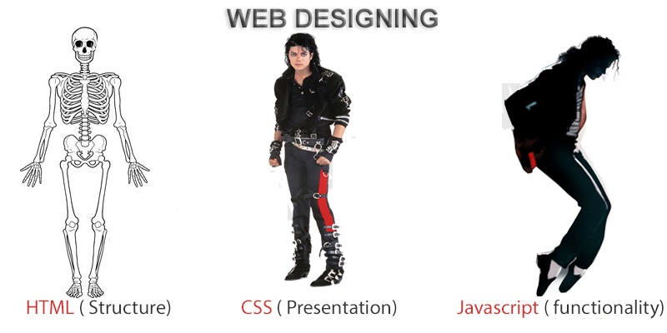
FRONTEND (LANGUAGE USED)
HTML (HYPERTEXT MARKUP LANGUAGE)
CSS (CASCADING STYLE SHEET)
BOOTSTRAP (FRAMEWORK OF CSS AND JS)

Slide 16

BACKEND
PYTHON DJANGO
SQLITE (DATABASE)

Slide 17
SOFTWARE USED
PYTHON INTERPRETER
PYCHARM IDE (INTEGRATED DEVELOPMENT ENVIRONMENT)
NOTEPAD++ OR ANY OTHER TEXT EDITOR
CHROME OR ANY OTHER BROWSER

Slide 18
Algorithm Used:-
Gradient Boosting Classifier is a type of machine learning algorithm that combines multiple weak learners (decision trees) to create a strong predictive model. It works by sequentially adding decision trees, where each subsequent tree corrects the mistakes made by the previous trees. It uses gradient descent optimization to minimize a loss function and improve the overall model's performance.

Slide 19
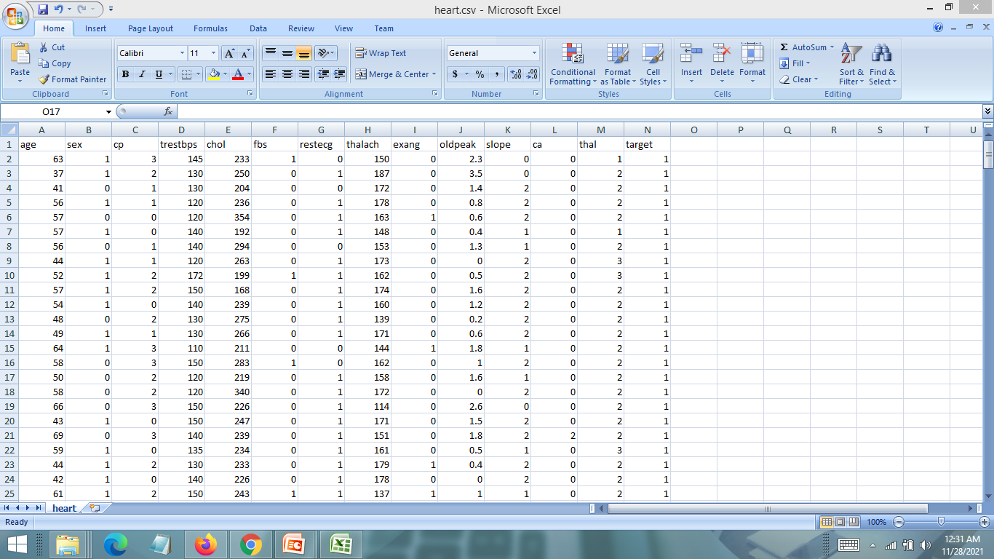
DATASET USED

Slide 20
PROJECT SCOPE
The Heart Disease Prediction System using Gradient boosting classifier has a broad scope, benefiting medical professionals and individuals concerned about heart health. It finds applications in healthcare and the medical industry, enabling accurate predictions and improving treatment outcomes. Pharmaceutical companies can also leverage its predictions for developing targeted therapies.

Slide 21
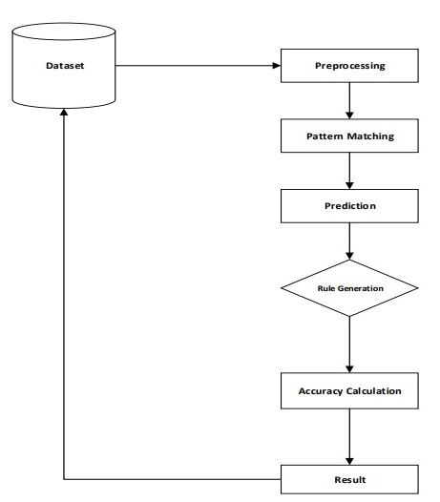
FLOW CHART

Slide 22
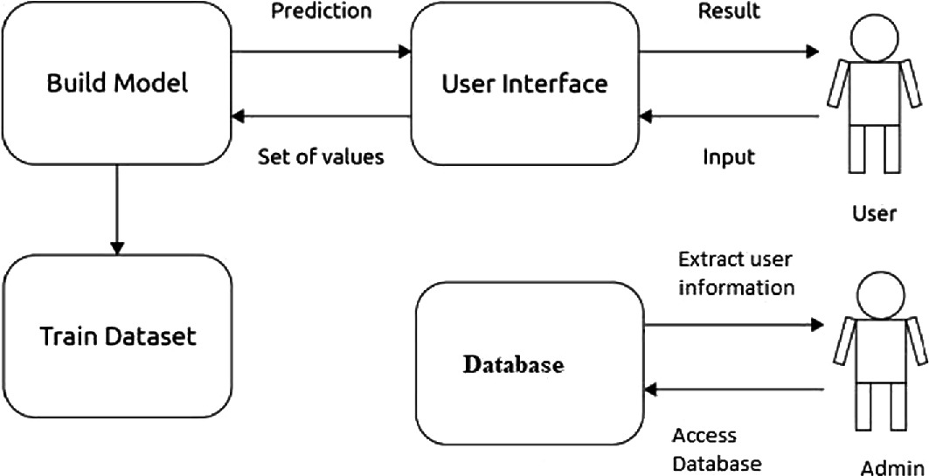
DFD(ABSTRACT LEVEL)

Slide 23
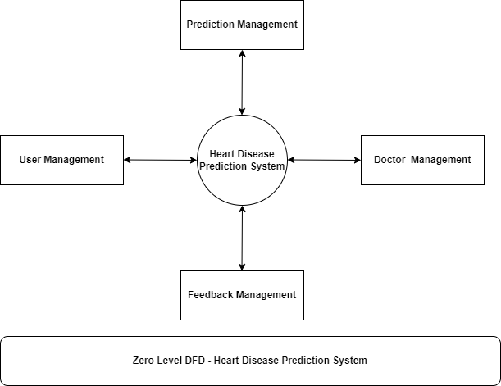
DFD(ZERO LEVEL)

Slide 24
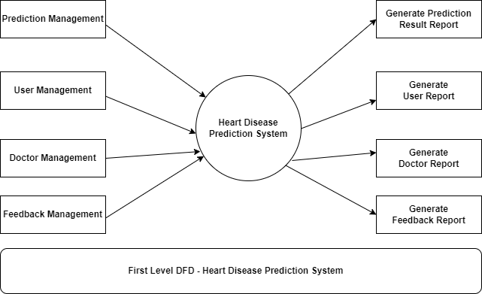
DFD(FIRST LEVEL)

Slide 25
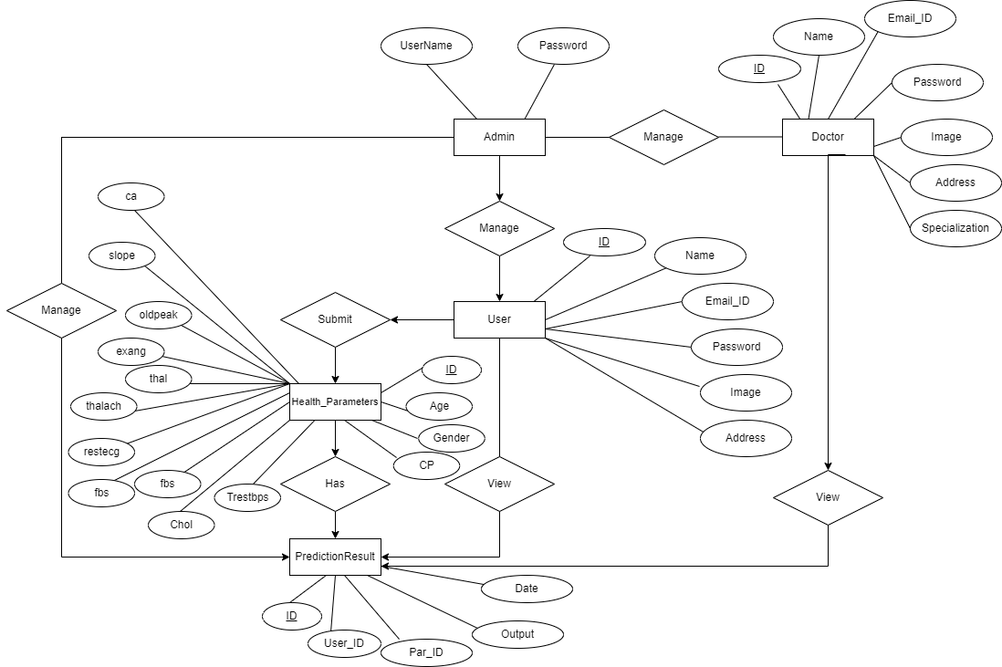
ER DIAGRAM

Slide 26
USE CASE DIAGRAM
Use case diagram consists of use cases and actors and shows the interaction between them. The key points are:
The main purpose is to show the interaction between the use cases and the actor.
To represent the system requirement from user’s perspective.
The use cases are the functions that are to be performed in the module.
An actor could be the end-user of the system or an external system.

Slide 27
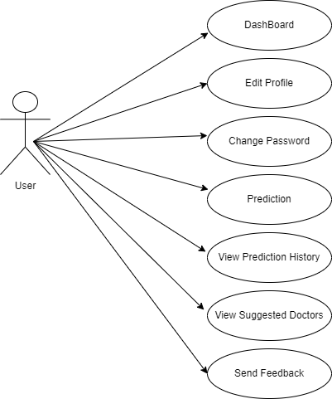
USE CASE DIAGRAM - USER

Slide 28
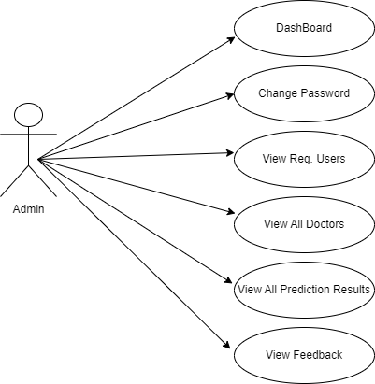
USE CASE DIAGRAM - ADMIN

Slide 29
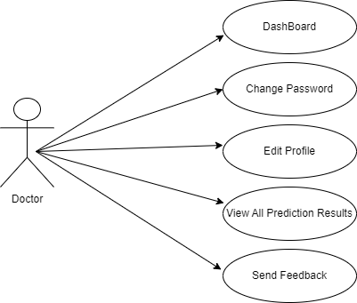
USE CASE DIAGRAM - DOCTOR

Slide 30
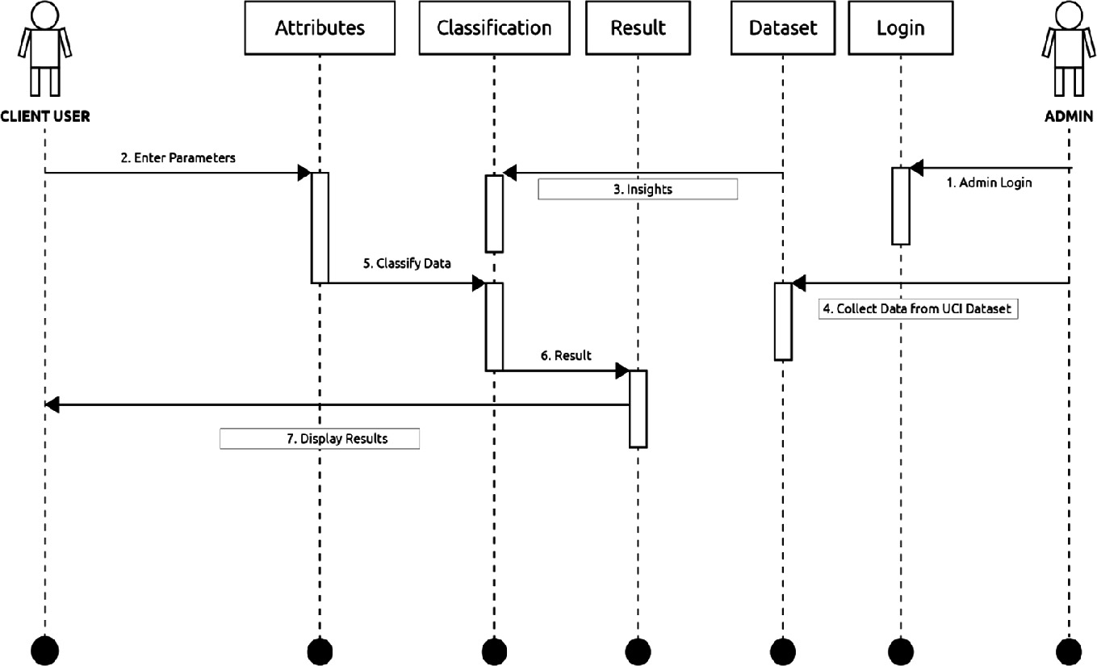
ACTIVITY DIAGRAM

Slide 31
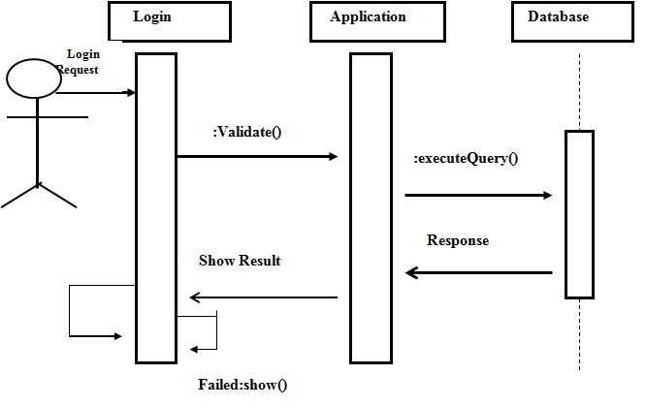
SEQUENCE DIAGRAM

Slide 32
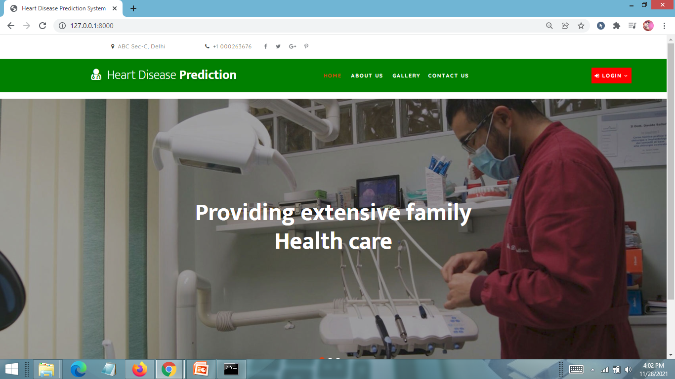
HOME PAGE

Slide 33
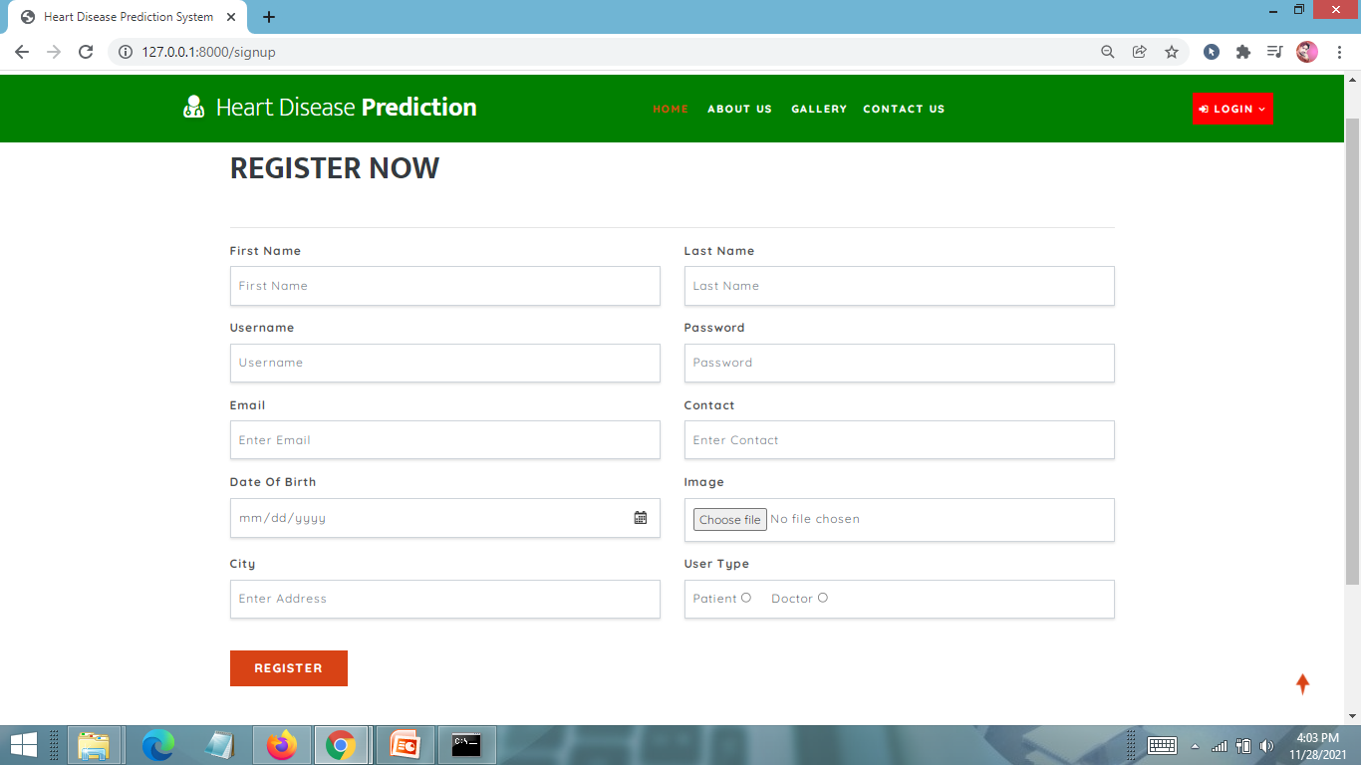
USER REGISTRATION PAGE

Slide 34
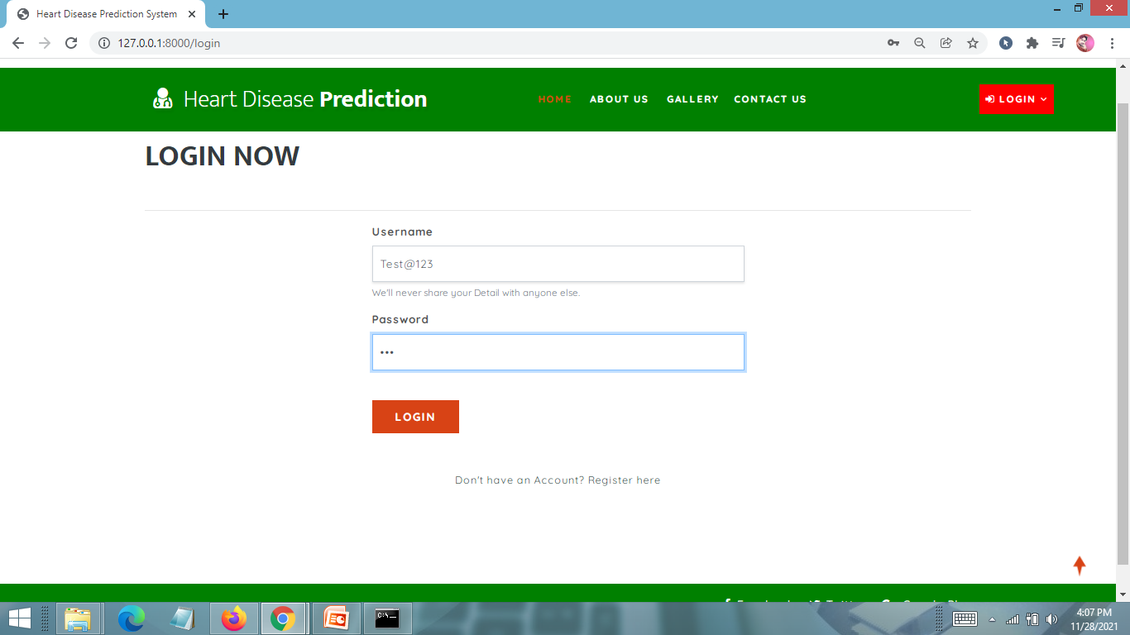
LOGIN PAGE

Slide 35
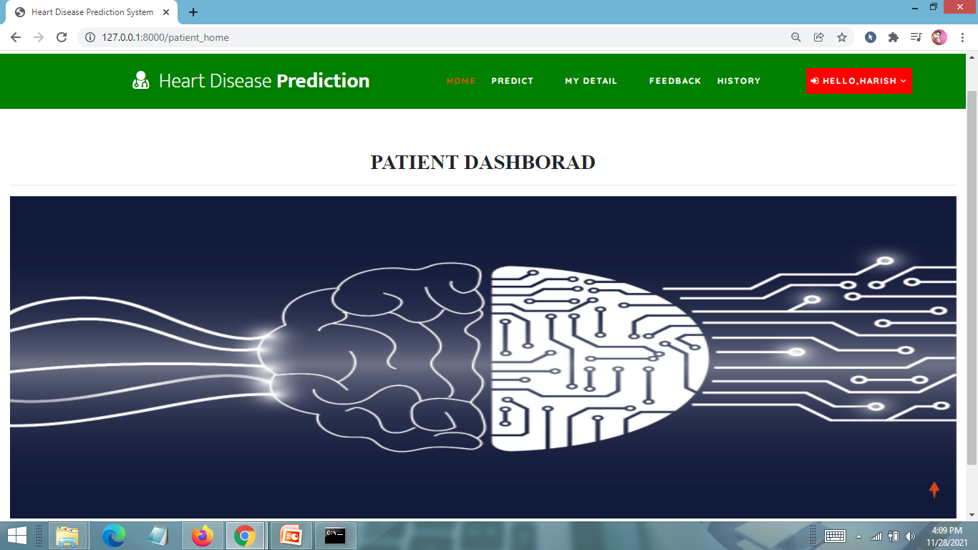
PATIENT HOME PAGE

Slide 36
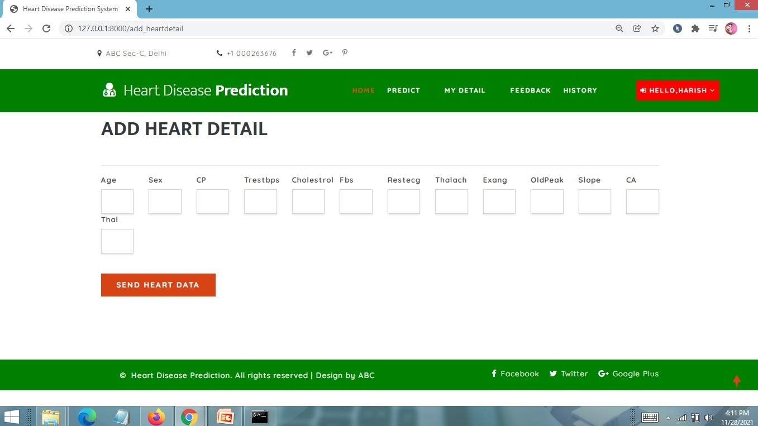
INPUT ATTRIBUTE VALUES PAGE

Slide 37
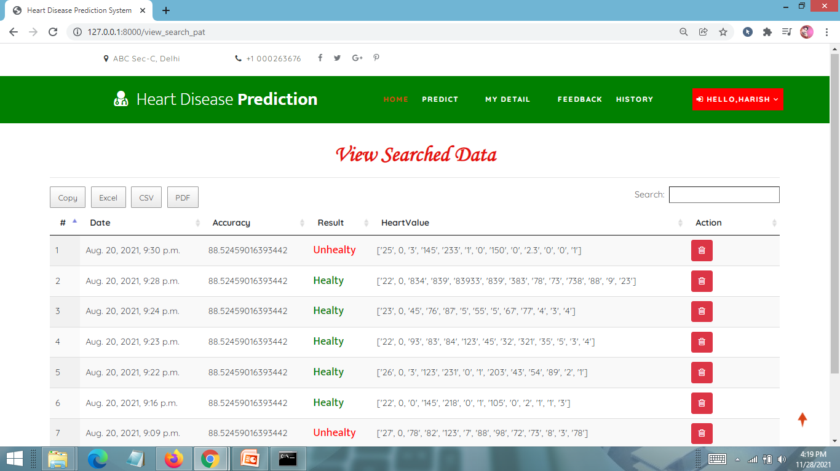
VIEW DISEASE PREDICTION RESULT PAGE

Slide 38
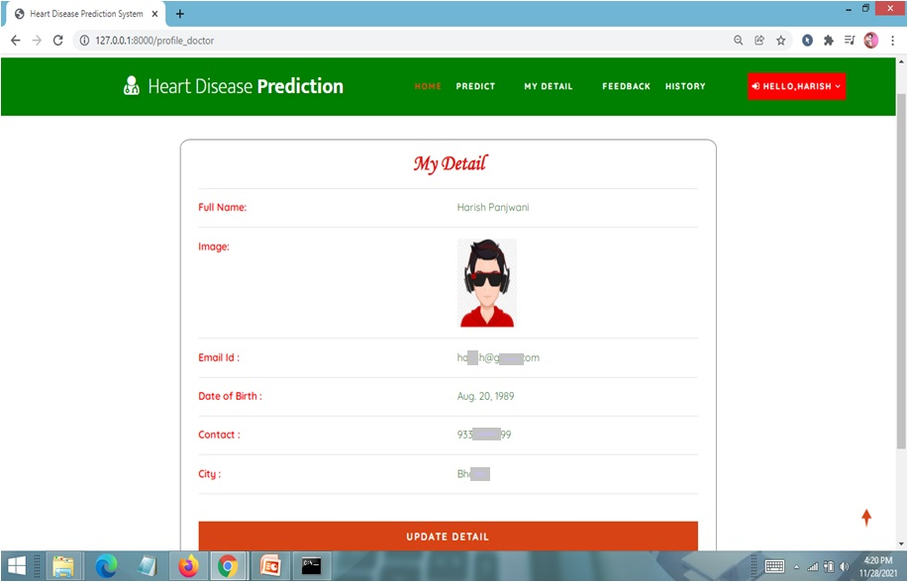
USER PROFILE PAGE

Slide 39
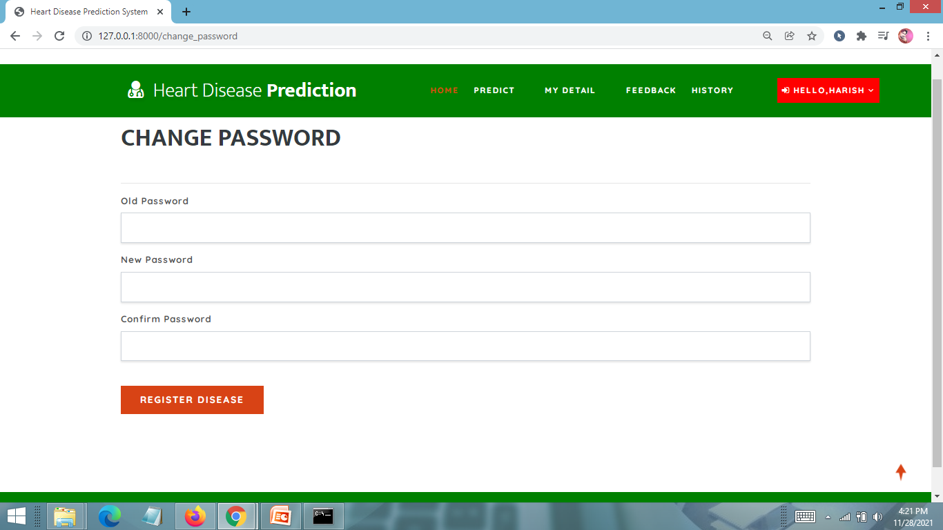
CHANGE PASSWORD PAGE

Slide 40
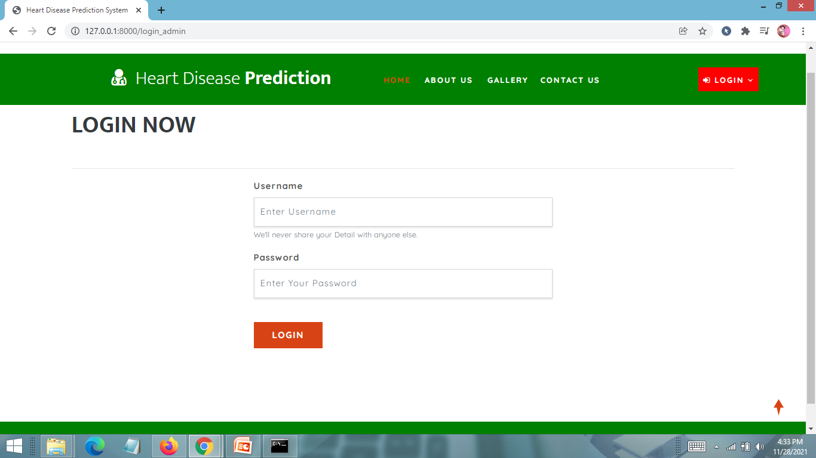
ADMIN LOGIN PAGE

Slide 41
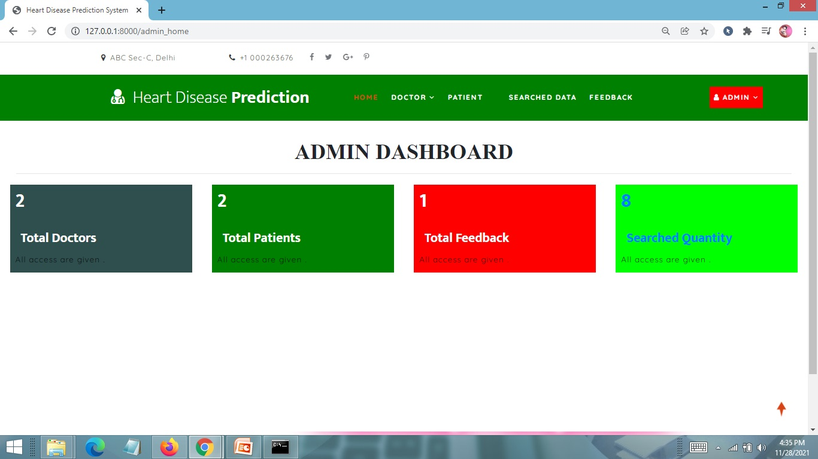
ADMIN HOME PAGE

Slide 42
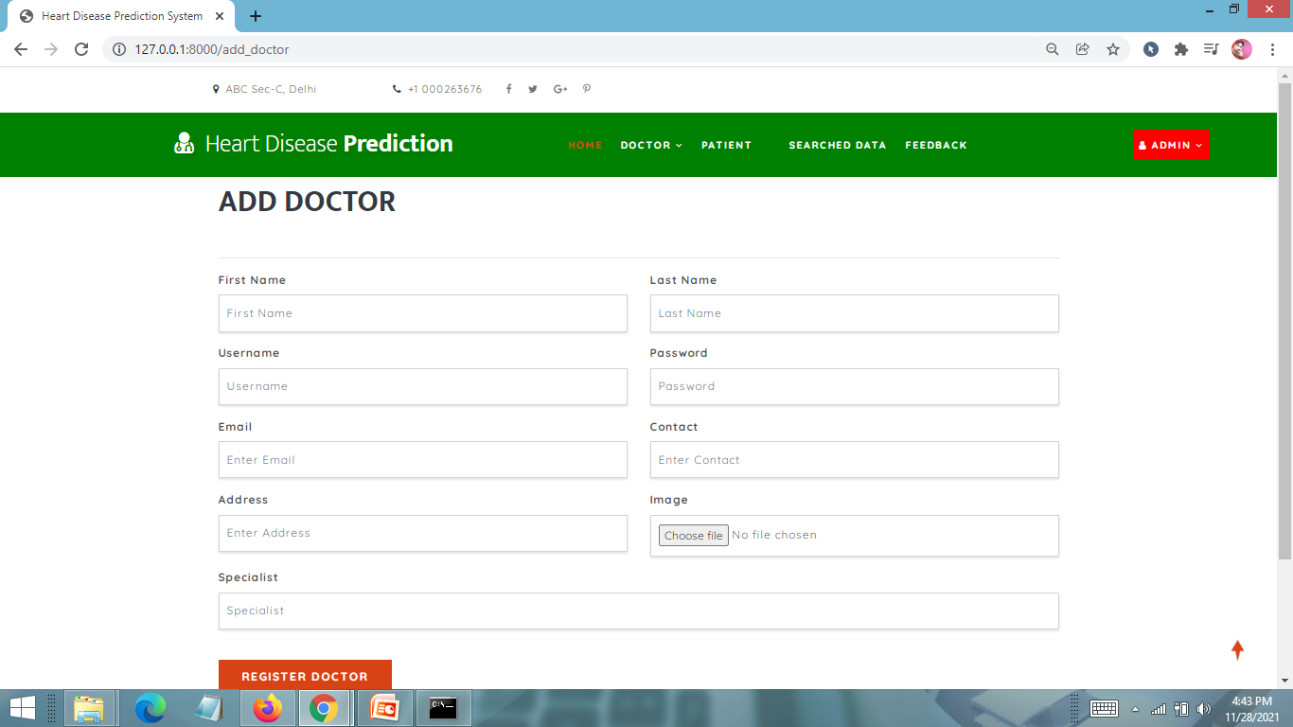
ADD DOCTOR INFO PAGE

Slide 43
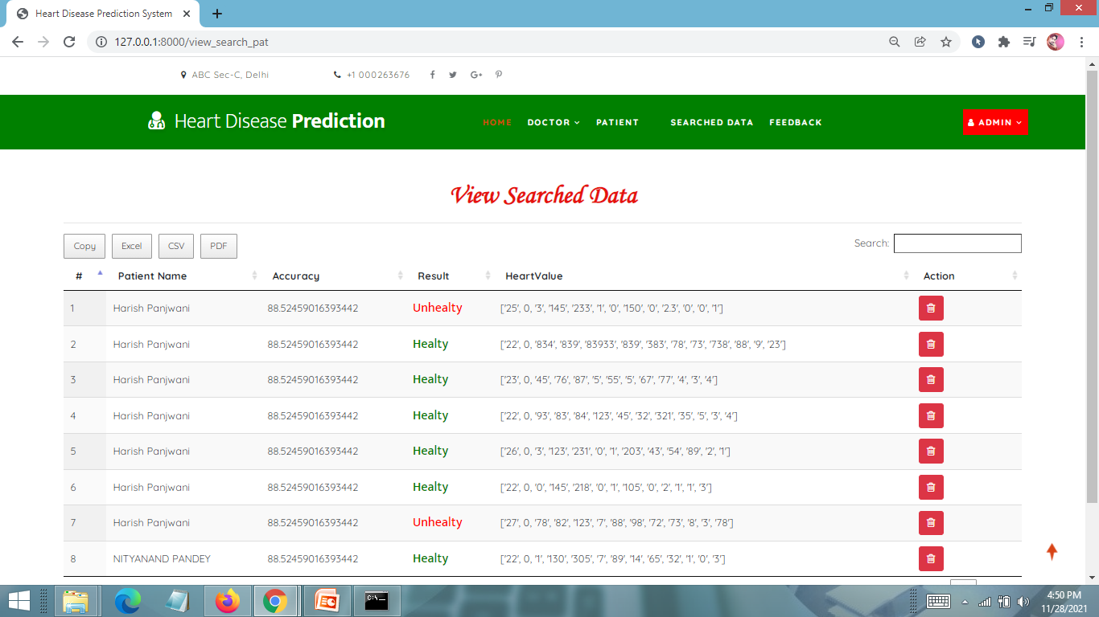
VIEW PREDICTION RESULTS PAGE

Slide 44
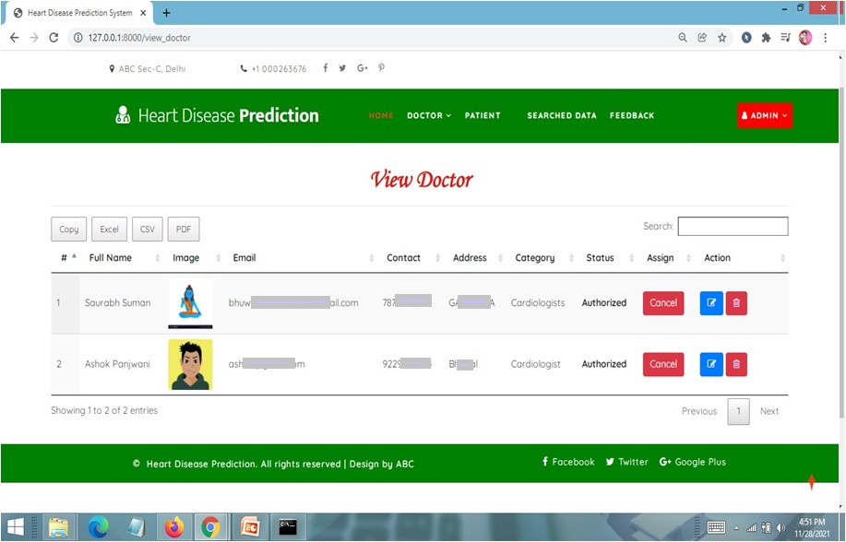
VIEW ALL DOCTORS PAGE

Slide 45
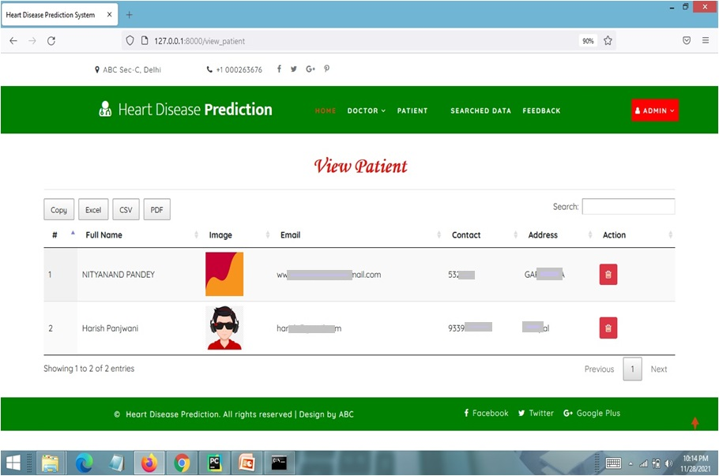
VIEW ALL PATIENT INFO PAGE

Slide 46
FUTURE SCOPE
The future scope of the Heart Disease Prediction System using Gradient boosting classifier includes enhanced prediction accuracy, integration of advanced machine learning algorithms, real-time monitoring and alerts, integration with electronic health records (EHR), mobile application development for remote monitoring, collaborative research and data sharing, personalized risk assessment and preventive measures, and integration with telemedicine platforms. These advancements aim to improve the accuracy of heart disease prediction, enable personalized care, and enhance remote monitoring capabilities.

Slide 47
CONCLUSION
In conclusion, the Heart Disease Prediction System using Gradient boosting classifier is a valuable tool in healthcare that aids in early detection and prevention of heart disease. It offers accurate predictions, user-friendly interface, and efficient data analysis. While it has limitations, ongoing research can address them. The system holds potential for the medical industry and individuals seeking risk assessment. Future enhancements include advanced algorithms, integration with healthcare systems, and personalized interventions. By improving and updating the system, we can improve heart disease management and overall well-being.

Slide 48
BIBLIOGRAPHY
FOR PYTHON INSTALLATION
https://www.python.org
FOR HTML , CSS AND PYTHON BASICS
www.w3schools.com
www.javatpoint.com
https://www.geeksforgeeks.org/python-django/
https://panjwanitutorials.com/

Slide 49
BIBLIOGRAPHY
REFERENCE BOOKS
"Hands-On Machine Learning with Scikit-Learn and TensorFlow" by Aurélien Géron.
"Python Machine Learning" by Sebastian Raschka and Vahid Mirjalili.
"Pattern Recognition and Machine Learning" by Christopher M. Bishop.
"Machine Learning: A Probabilistic Perspective" by Kevin P. Murphy.
"Healthcare Analytics: From Data to Knowledge to Healthcare Improvement" by Hui Yang.
"Machine Learning in Medicine: A Complete Overview" by Ton J. Cleophas and Aeilko H. Zwinderman.
"Data Science for Healthcare: Methodologies and Applications" by Radhakrishnan Nagarajan, Foyzur Rahman, and Arunima Srivastava.
Two scoops of Django for 1.11 by Daniel Greenfeld’s and Audrey Greenfield.
Lightweight Django by Elman and Mark Lavin.

Slide 50
THANKYOU

